Slide 1


Azure IaC with Bicep
an ode by a developer

Slide 2
IaC - What
Acronym
Infrastructure as Code
Author, manage, provision cloud infrastructure as code

Slide 3
IaC - Why
Consistency
Idempotency
Scalability
Secret management
Speed of deployment
Traceability
Integration with development processes
Understanding of cloud infrastructure

Slide 4
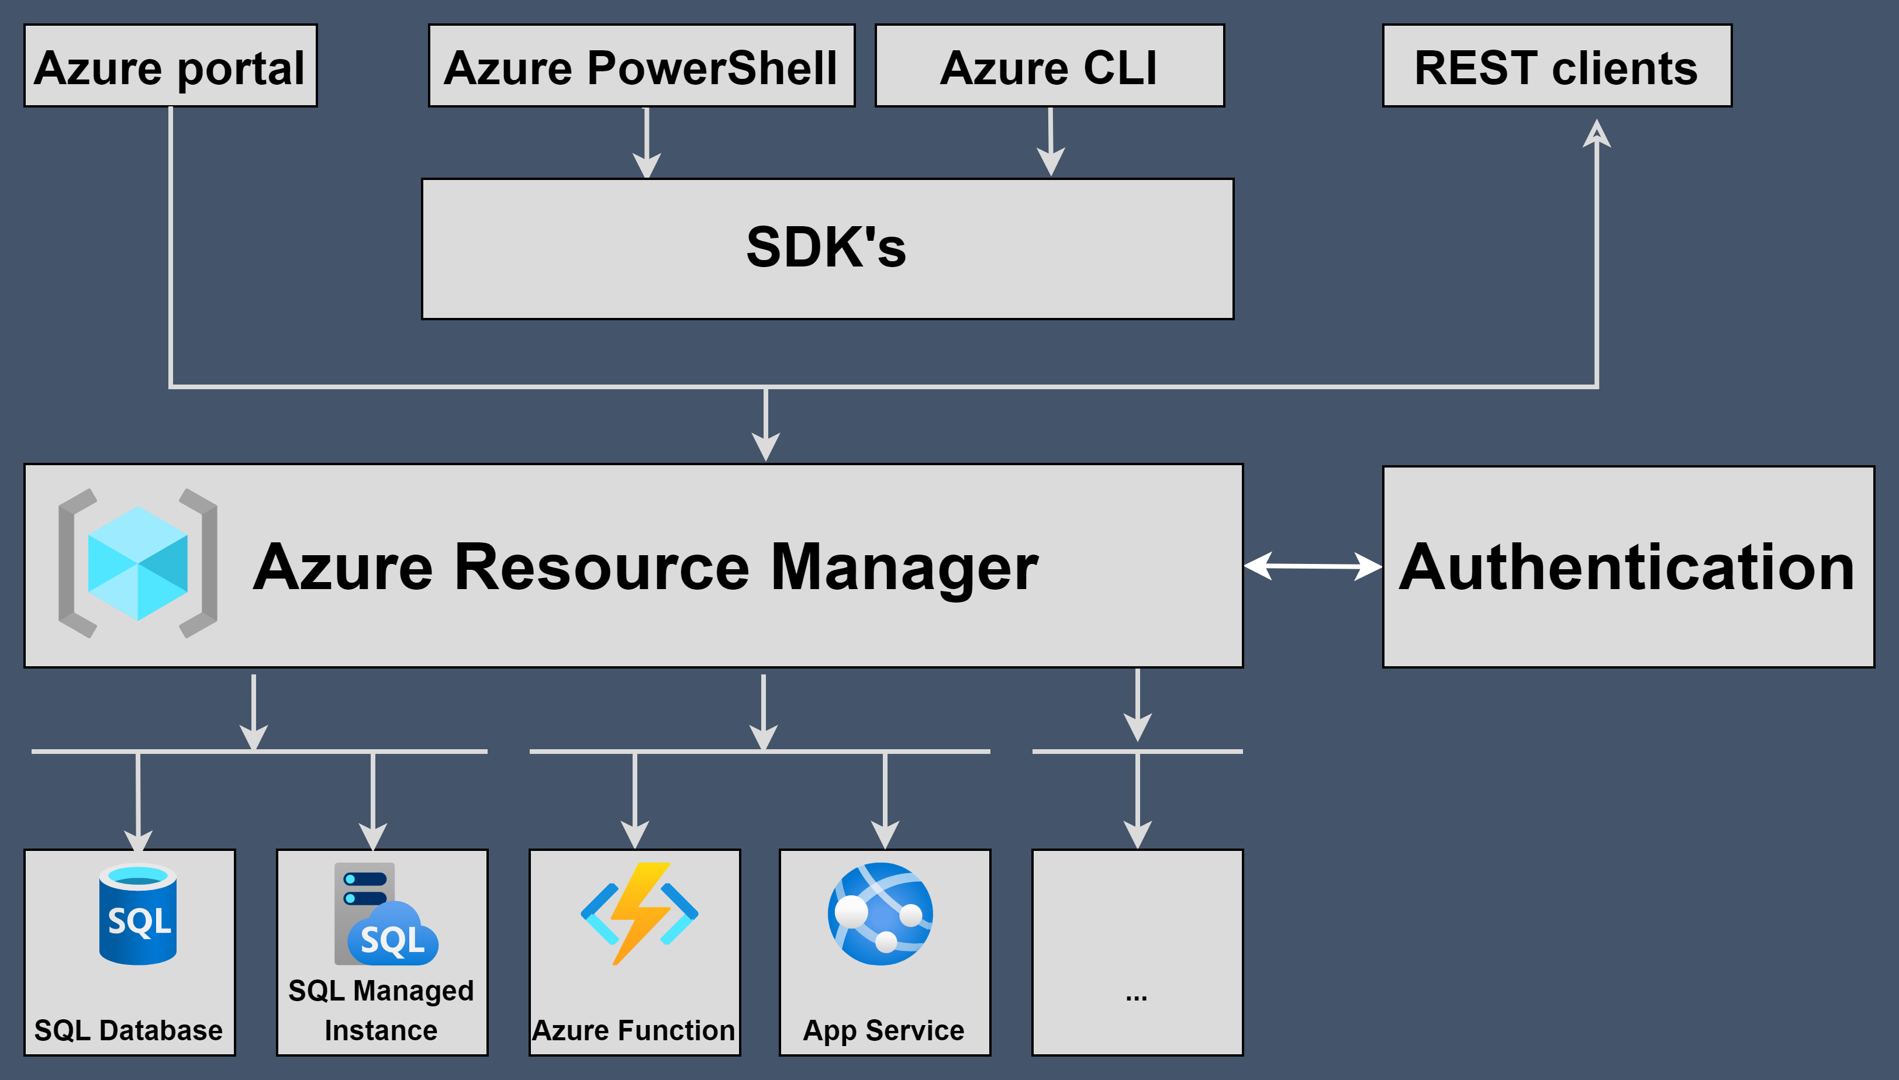
IaC – Architecture in Azure

Slide 5
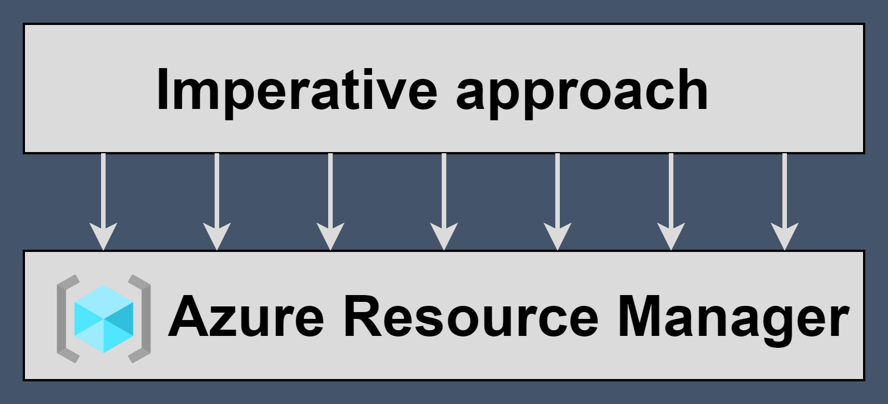
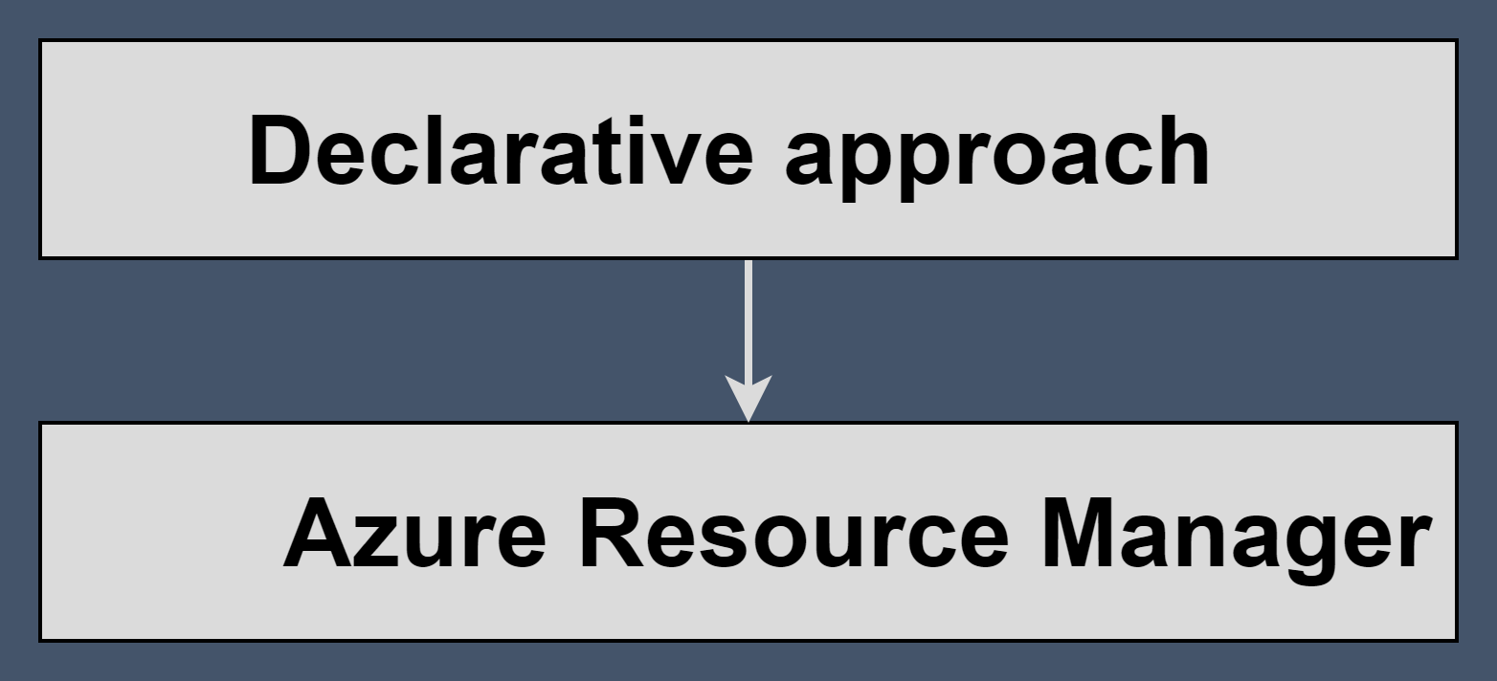
IaC – Programming approaches
Imperative
  How
  Azure CLI, Azure PowerShell
  Points of attention
    Idempotency
    Versioning
    Architecture
Declarative
  What
  Pulumi, Terraform, Farmer
  Azure: ARM templates (JSON, Bicep)

Slide 6
Bicep – What
DSL
Deploy and manage resources within Azure

Slide 7


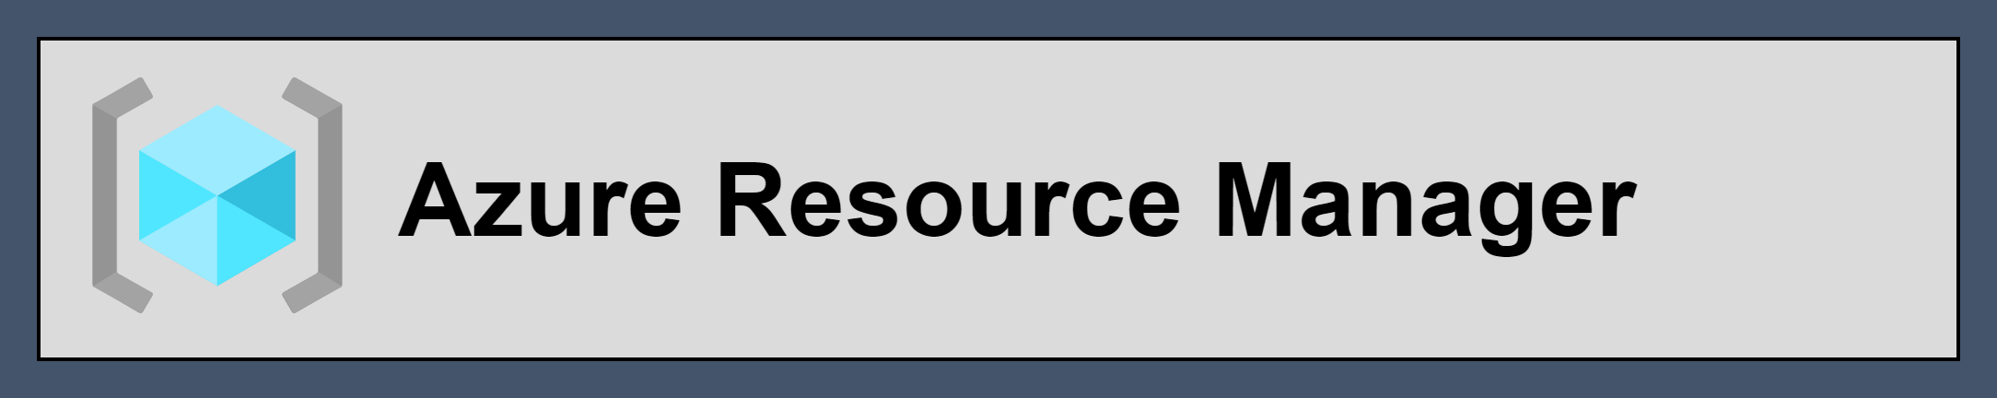
Bicep - How
bicep build
deployment

Slide 8
Bicep – Why
Azure Native
The way to go
Support for all resource types and API versions
Integration with Azure Services
Orchestration through ARM
Preview (what-if)

Slide 9
Bicep – Why
Developer experience
Simplicity
IDE
Modularity
Open source, active community
Documentation
Free

Slide 10
Bicep – When not
Multi cloud environment
Existing tooling

Slide 11
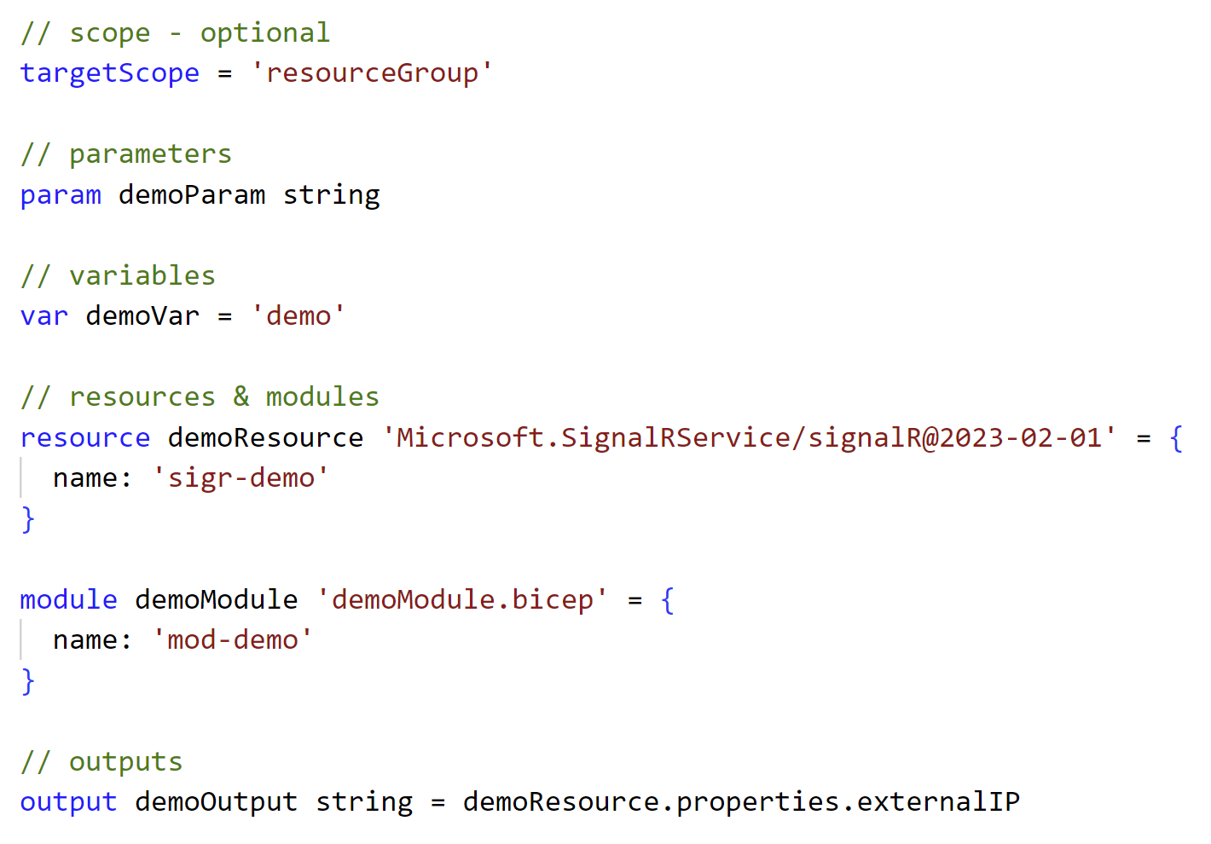
Bicep – Structure

Slide 12
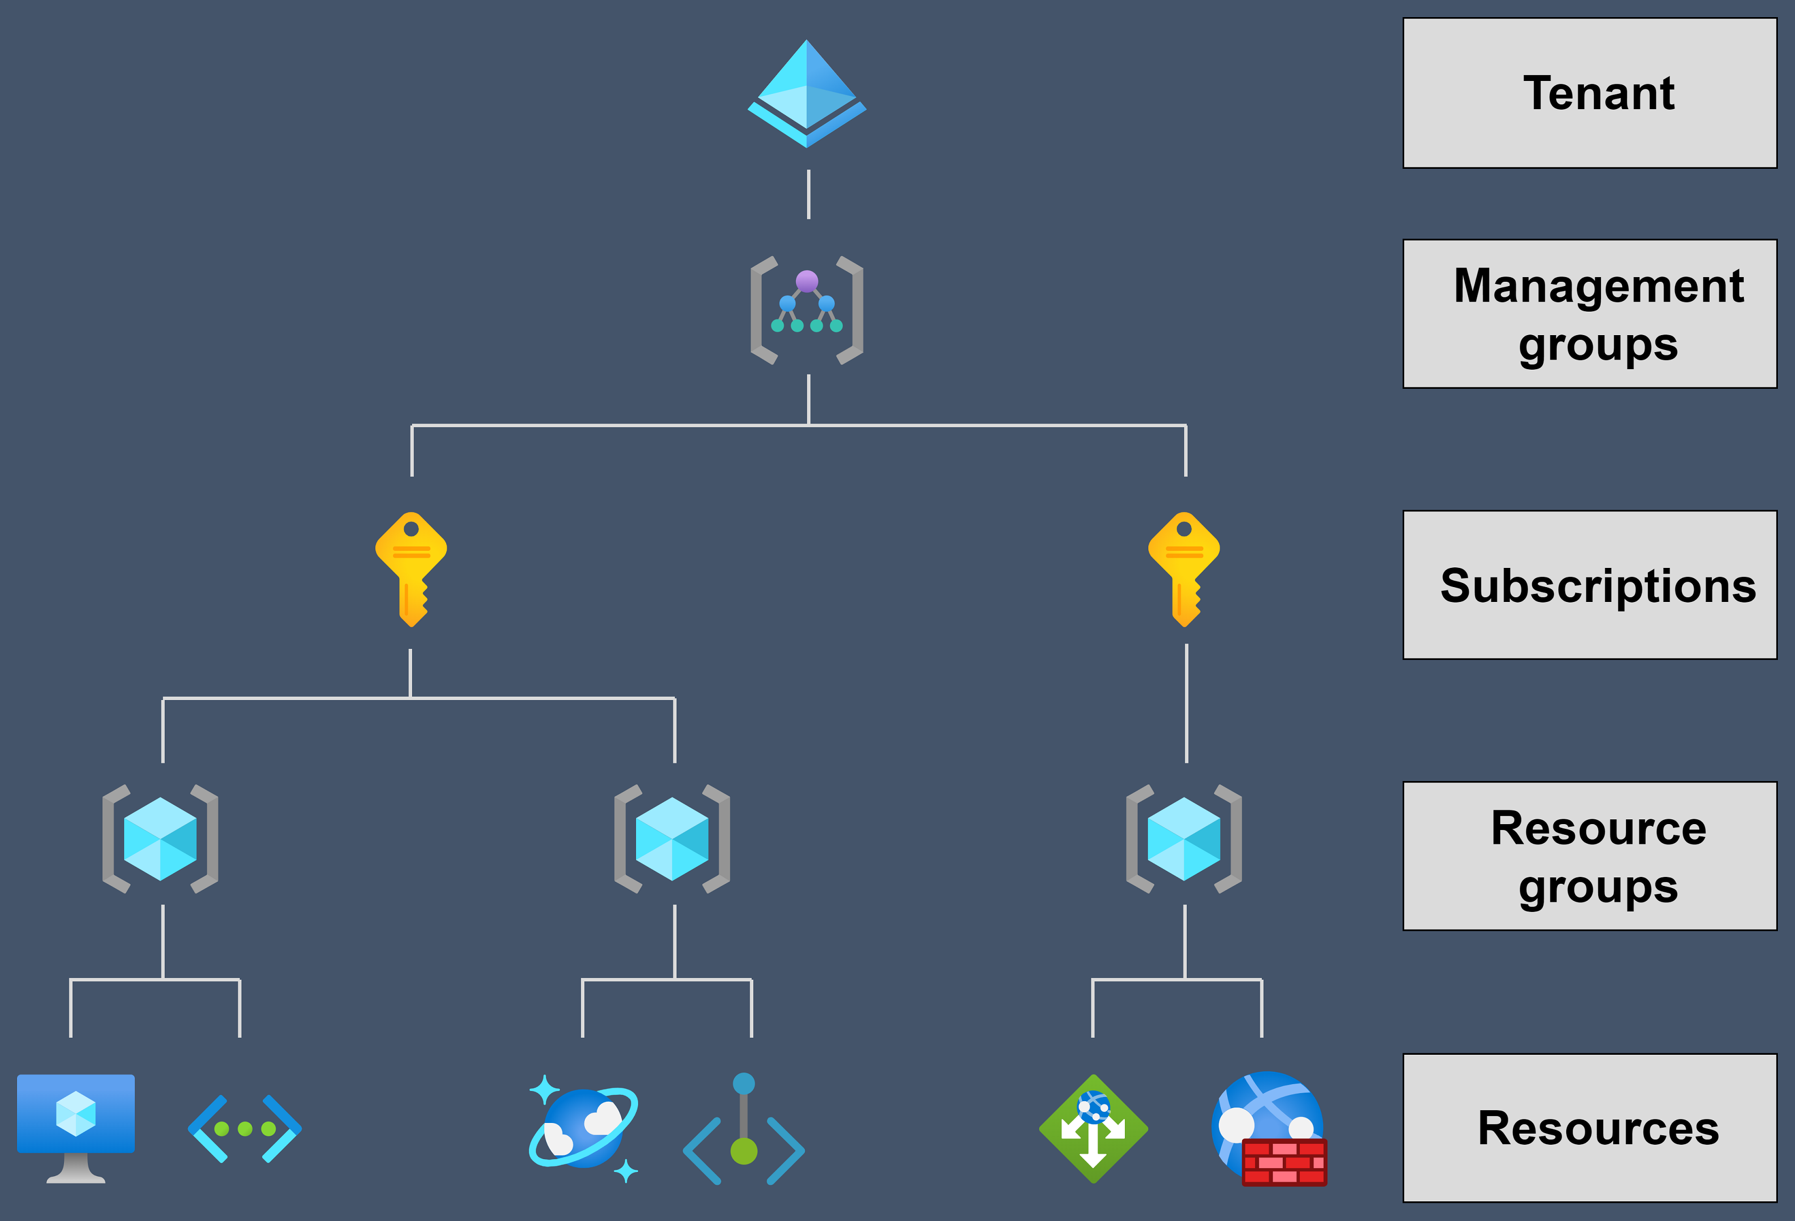






Scopes (targetScope)

Slide 13
Parameters (param)
Usage
Datatypes
Decorators
Secrets

Slide 14



Parameters (param) – datatypes examples

Slide 15
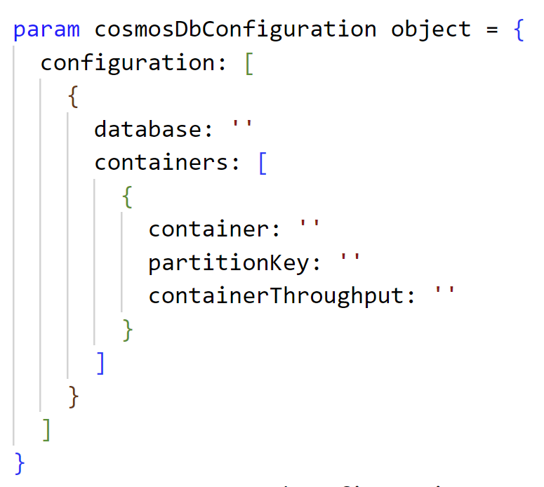
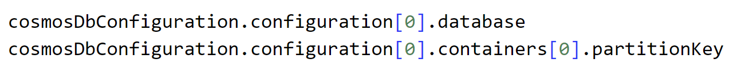
Parameters (param) –datatypes examples

Slide 16
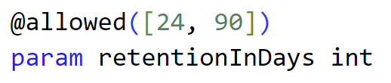
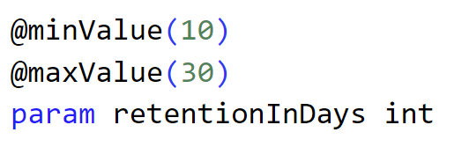
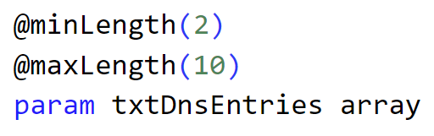
Parameters (param) – decorators examples

Slide 17
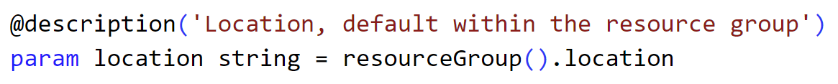
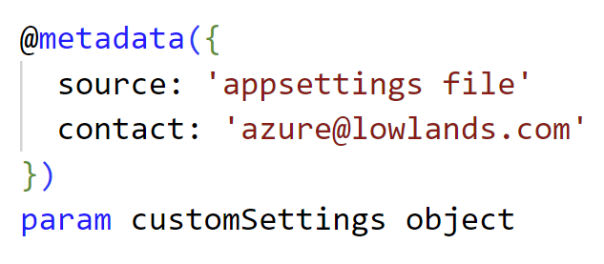
Parameters (param) – decorators examples

Slide 18
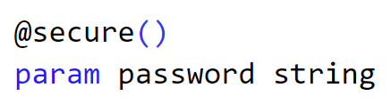
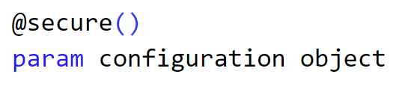
Parameters (param) – secrets examples

Slide 19

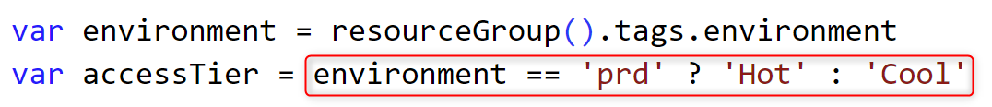
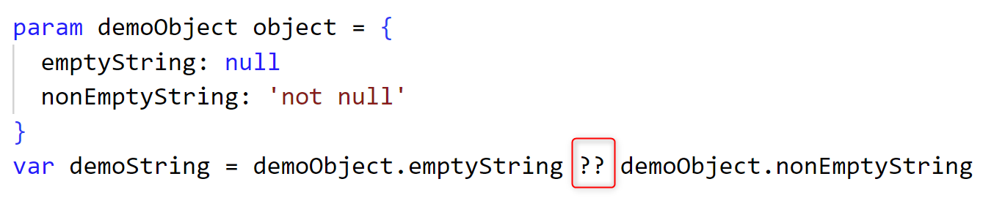
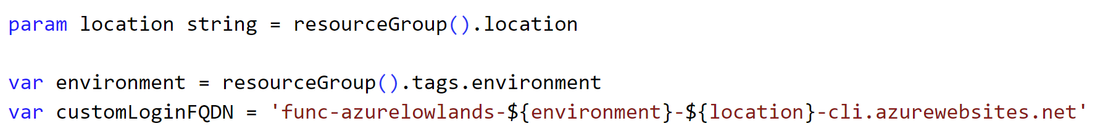
Variables (var) - examples

Slide 20
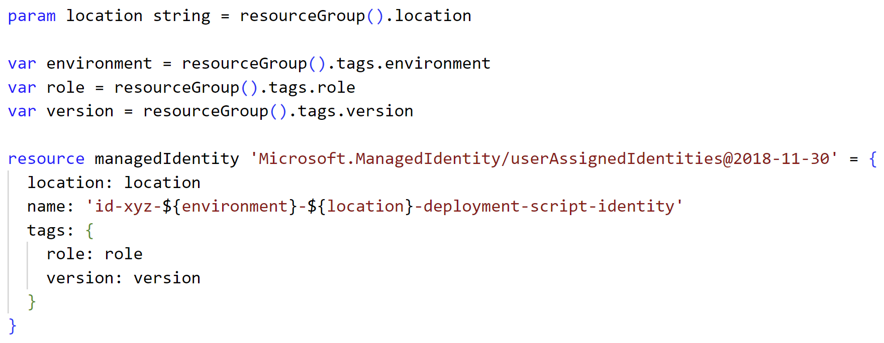
Resources (resource)

Slide 21
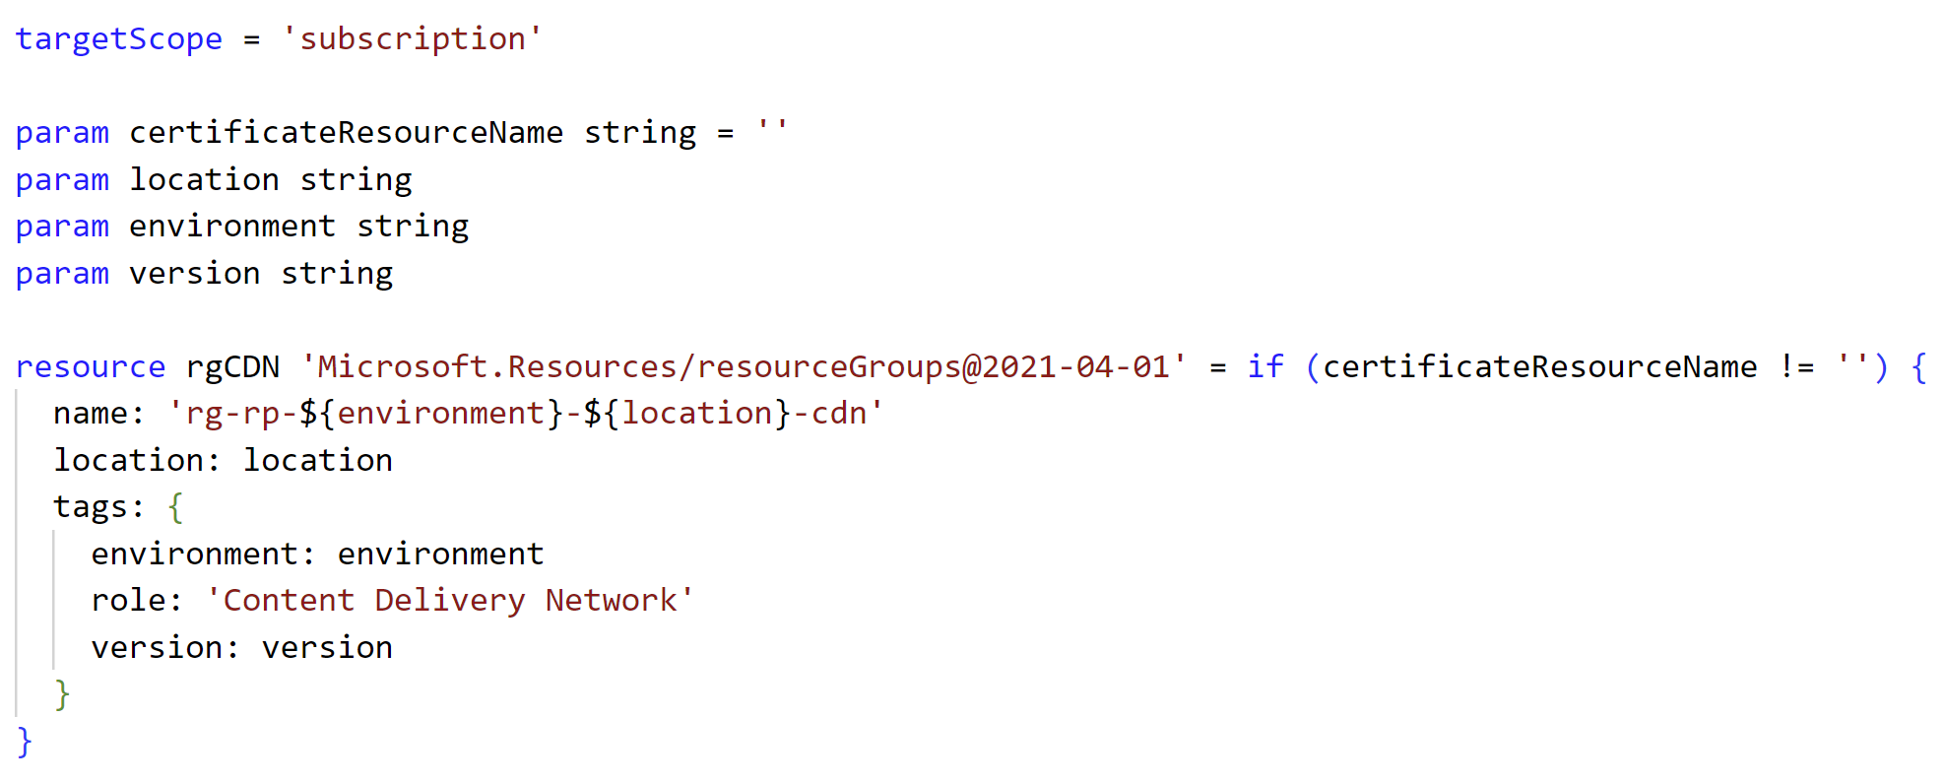
Resources (resource)
Conditional deployment

Slide 22
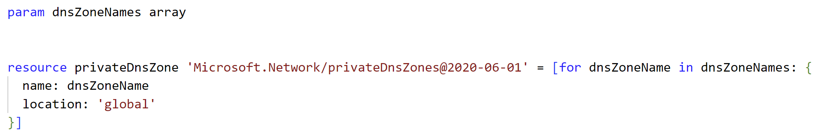
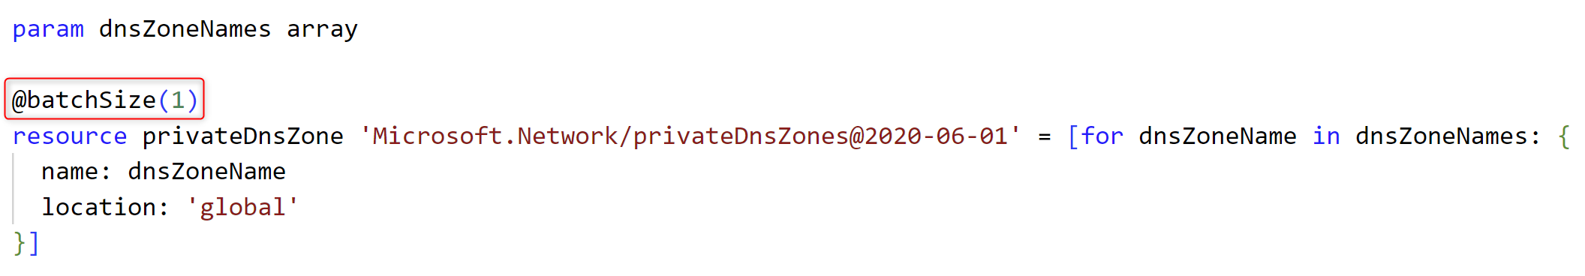
Resources (resource)
Iterative deployment

Slide 23
Resources (resource)
Child resources
Usage
Nested
Non-nested

Slide 24
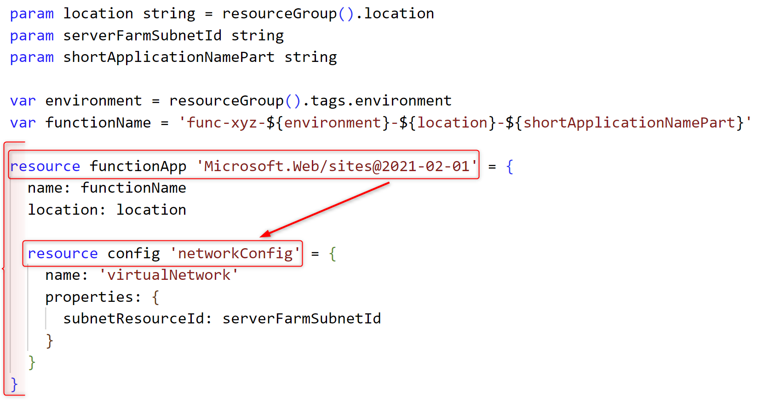
Resources (resource)
Child resources – nested example

Slide 25
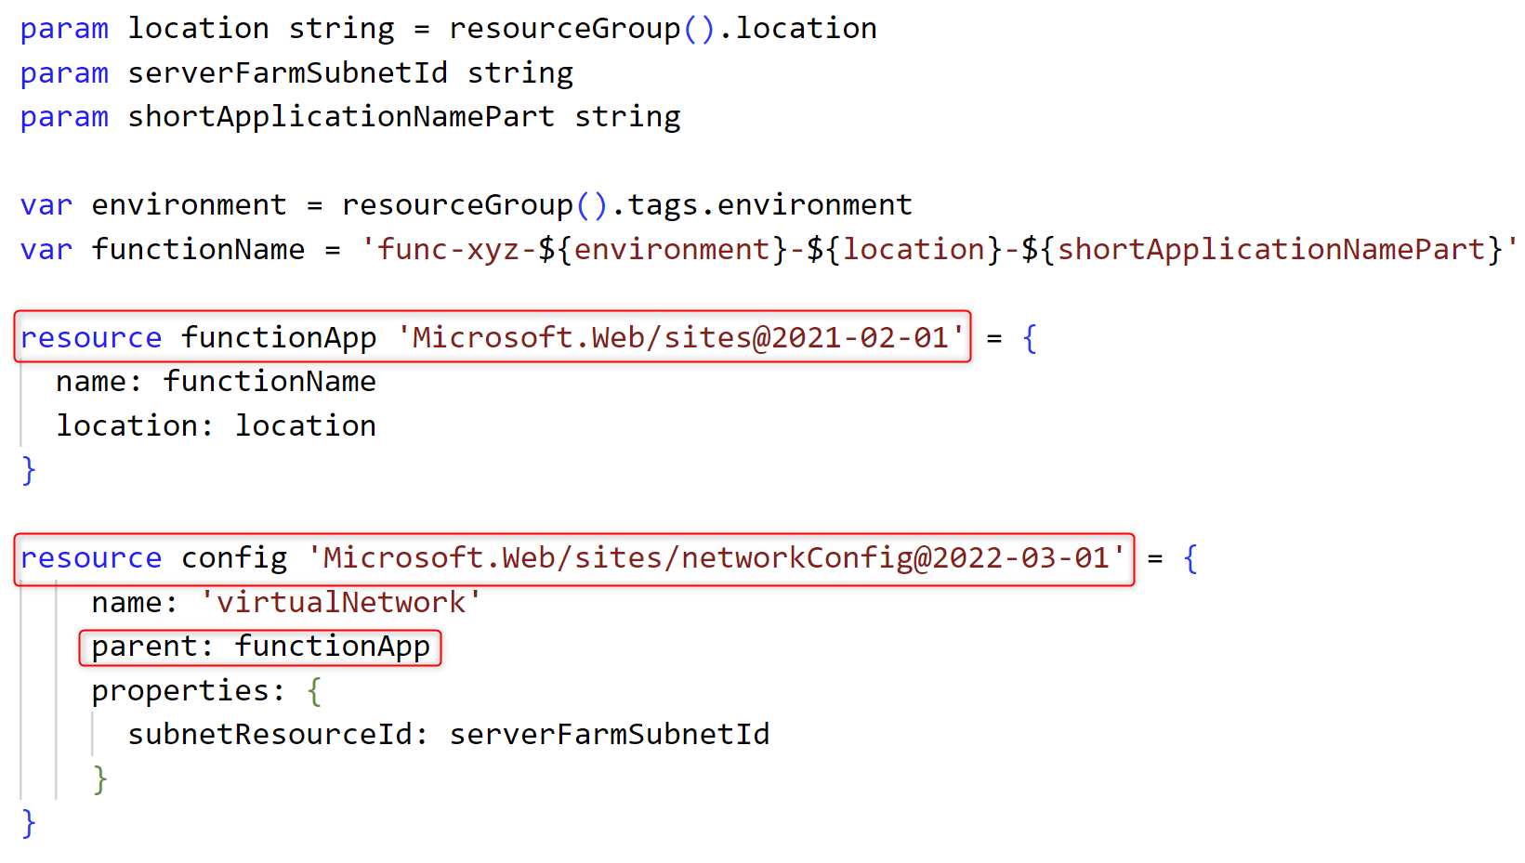
Resources (resource)
Child resources – non-nested example

Slide 26
Resources (resource)
Dependencies
Implicit
Explicit

Slide 27
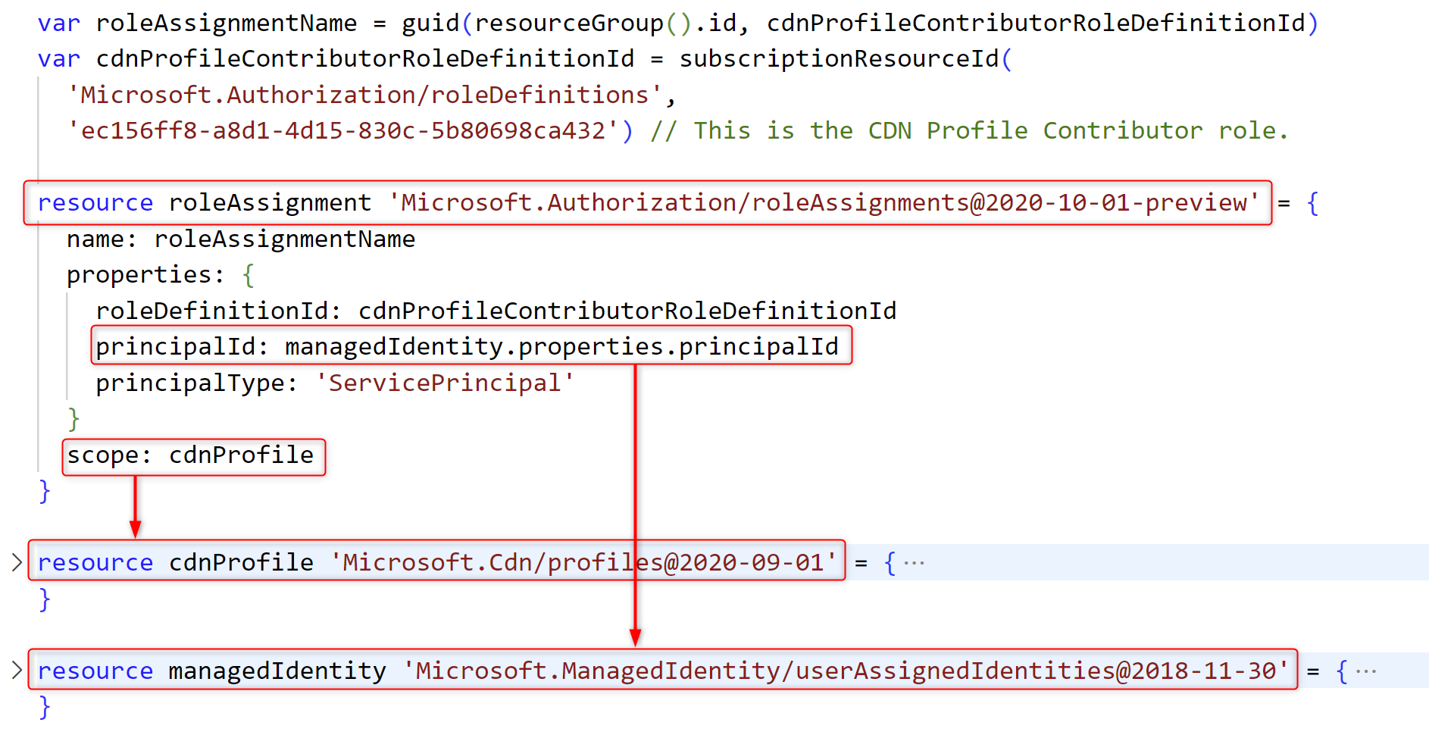
Resources (resource)
Dependencies – implicit example

Slide 28
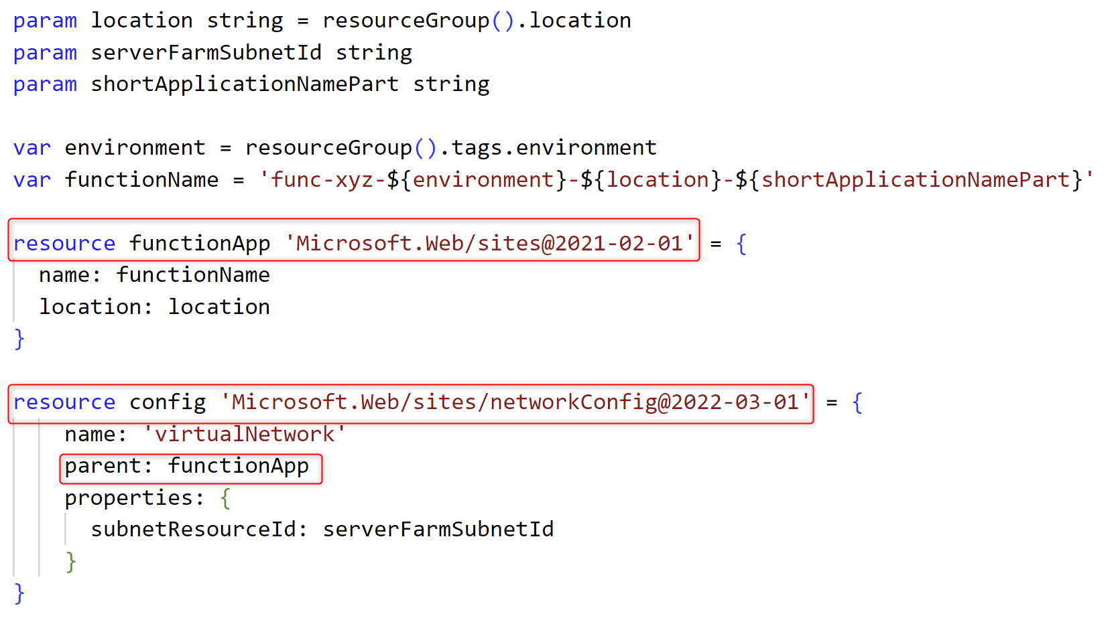
Resources (resource)
Dependencies – implicit example child

Slide 29
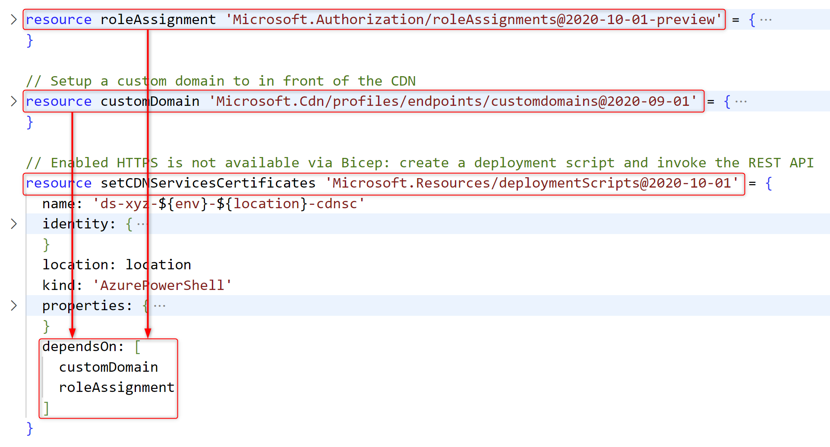
Resources (resource)
Dependencies – explicit example

Slide 30
Resources (resource)
Existing
Existing resources
No deployment
Scope

Slide 31
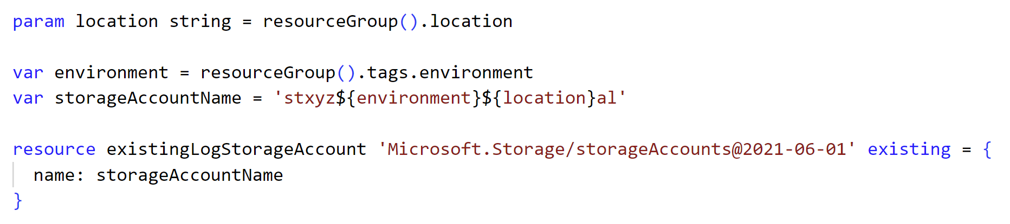
Resources (resource)
Existing – declaration example

Slide 32
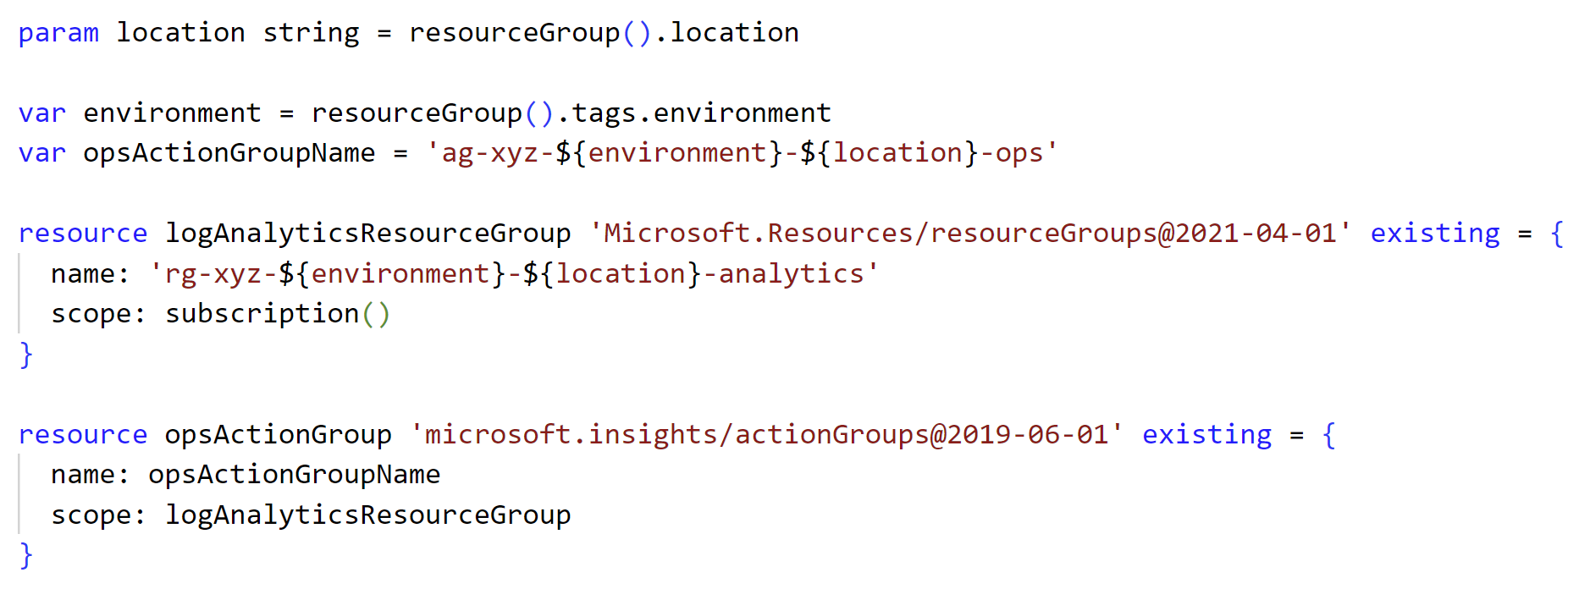
Resources (resource)
Existing – scope example

Slide 33
Modules (module)
What
Usage
  Encapsulation
  Conditional deployment
  Modularity
Dependencies

Slide 34
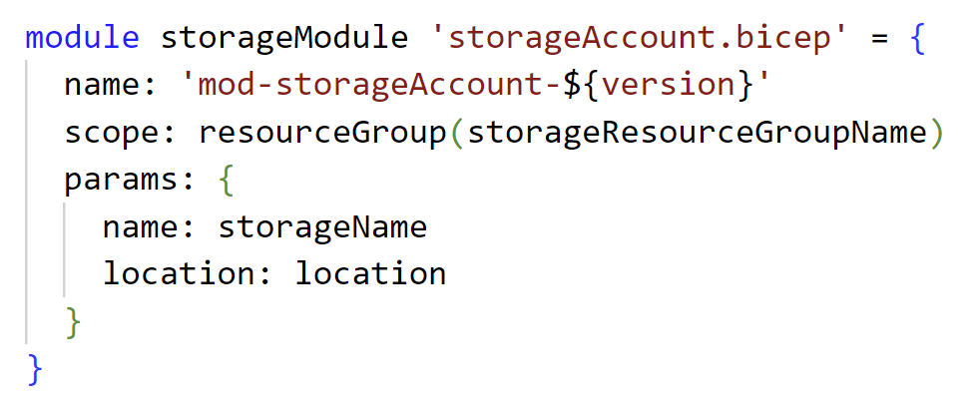
Modules (module) – declaration example

Slide 35
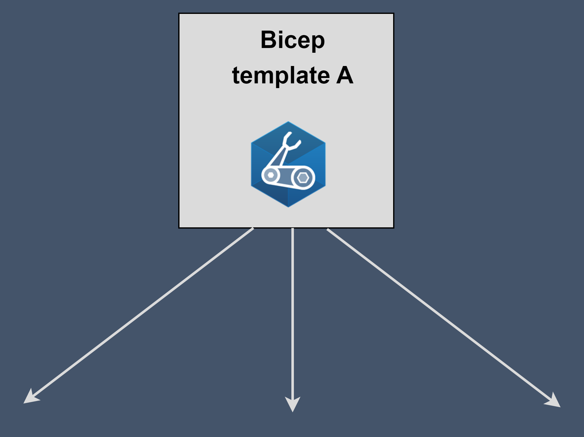
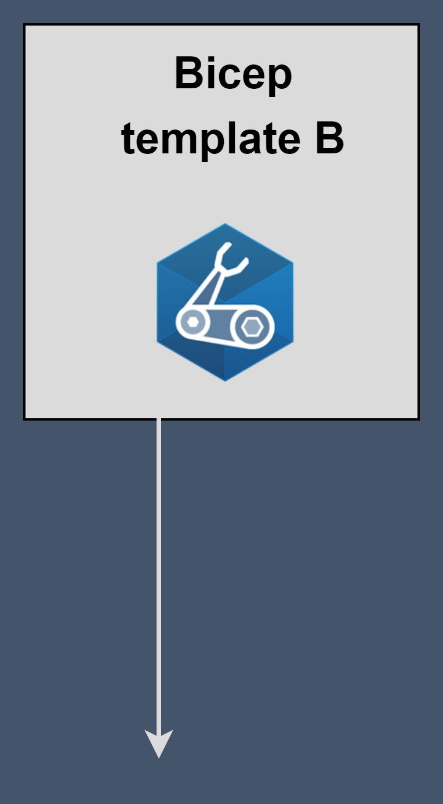
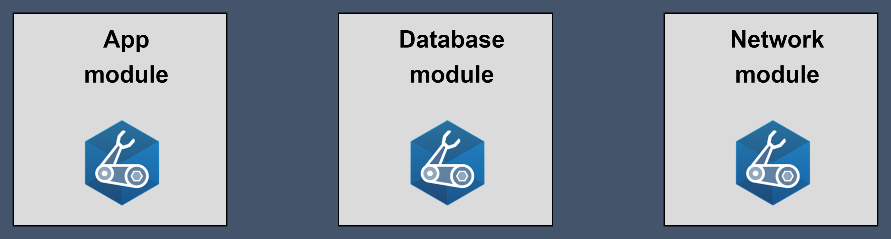
Modules (module) – encapsulation example

Slide 36
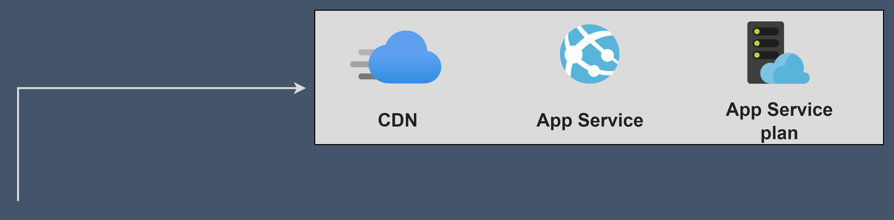

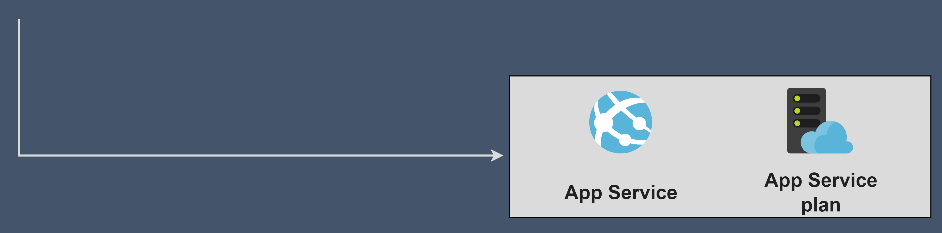
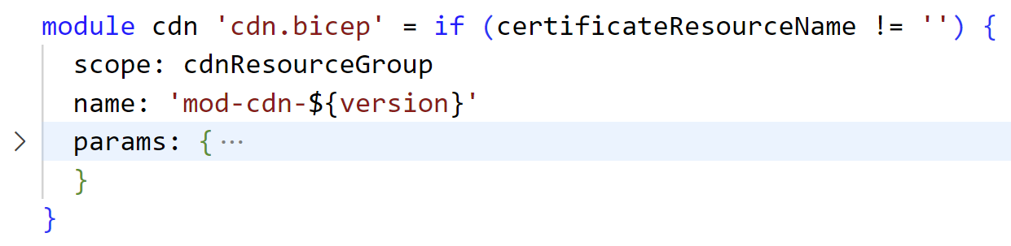
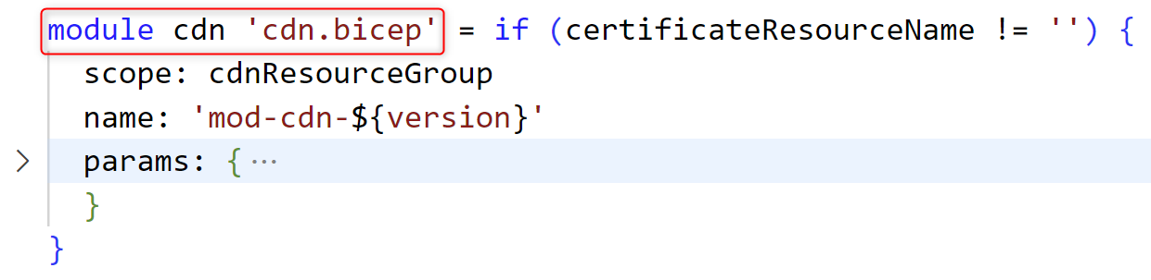
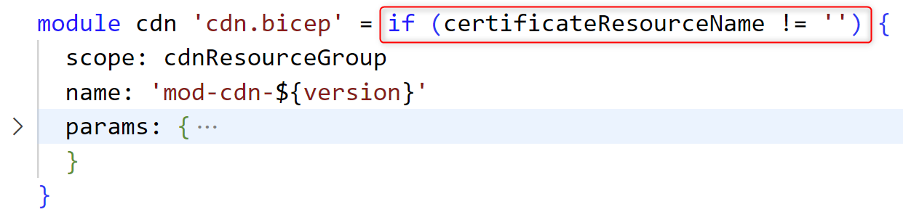
Modules (module) – conditional deployment example

Slide 37
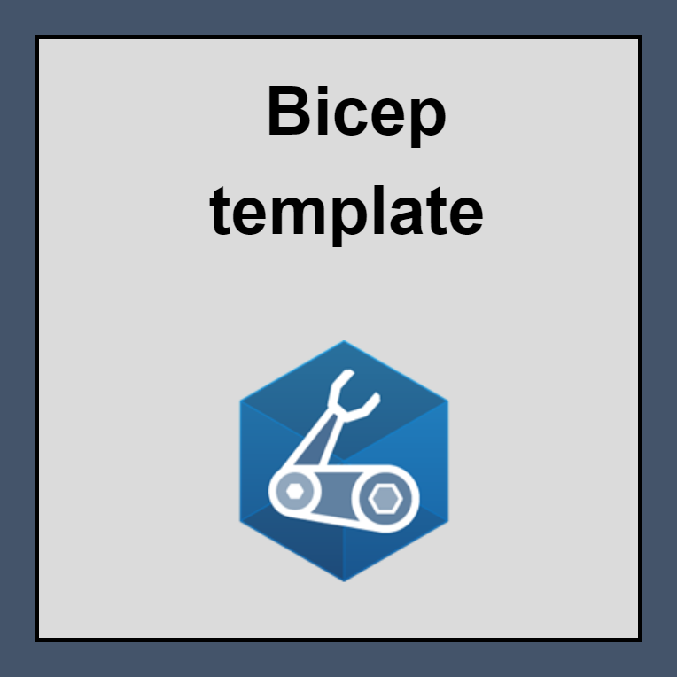
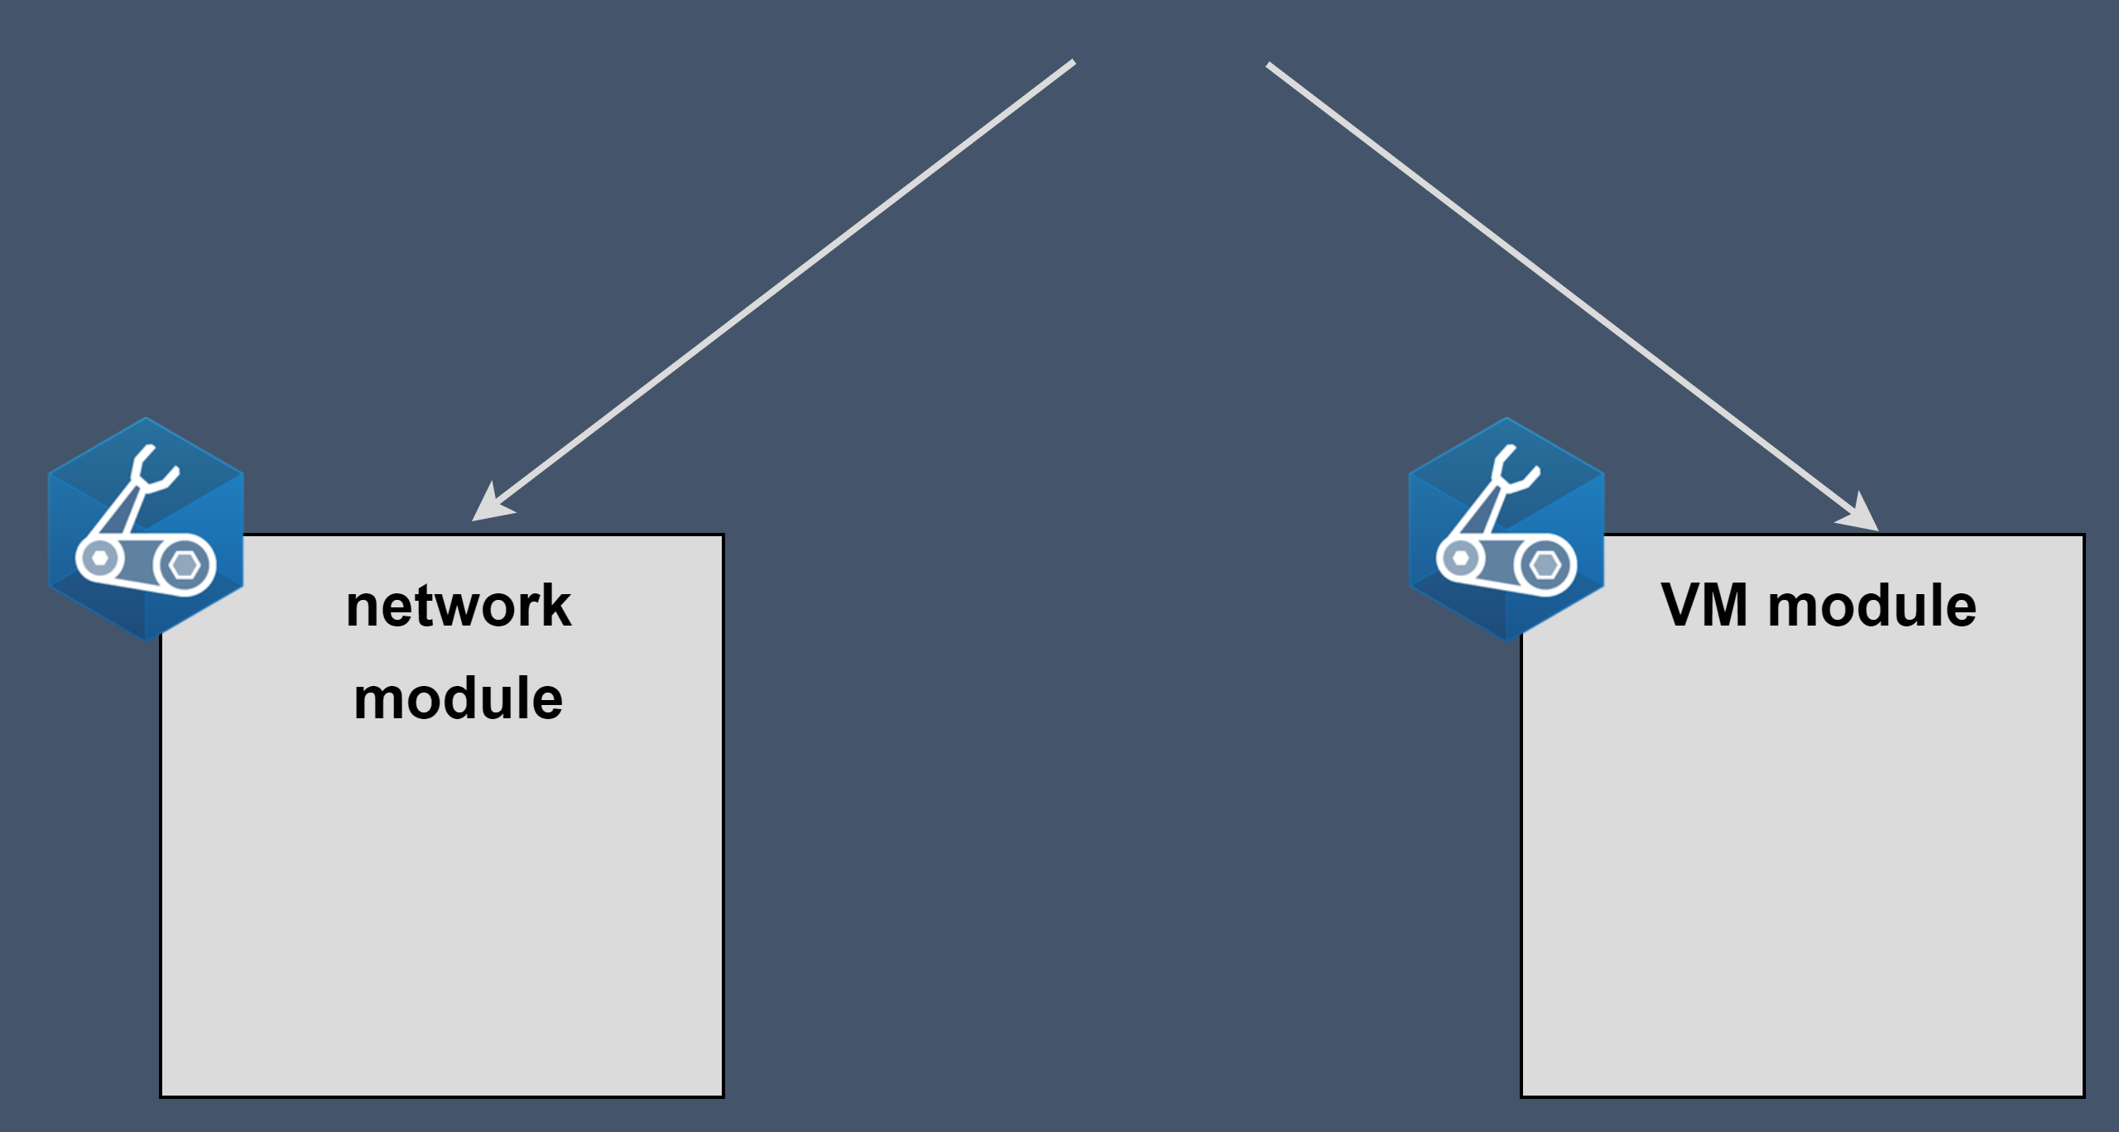
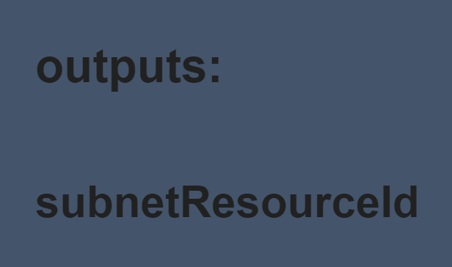
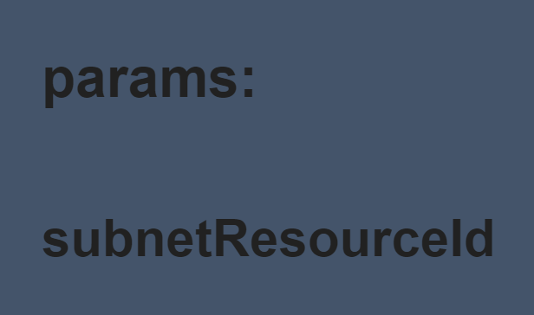

Modules (module) – modularity example

Slide 38
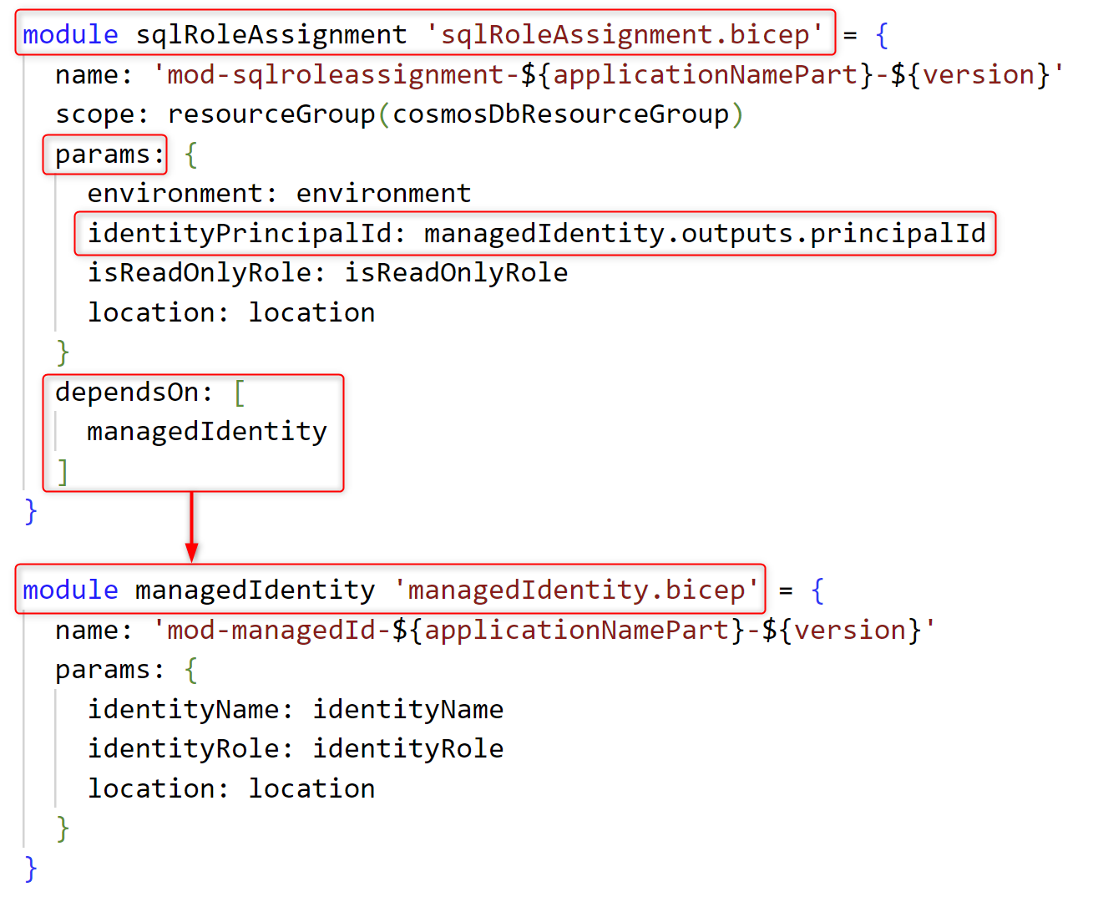
Modules (module) – dependencies example

Slide 39
Outputs (output)
What
Usage
Secret management

Slide 40
Outputs (output) – declaration example

Slide 41
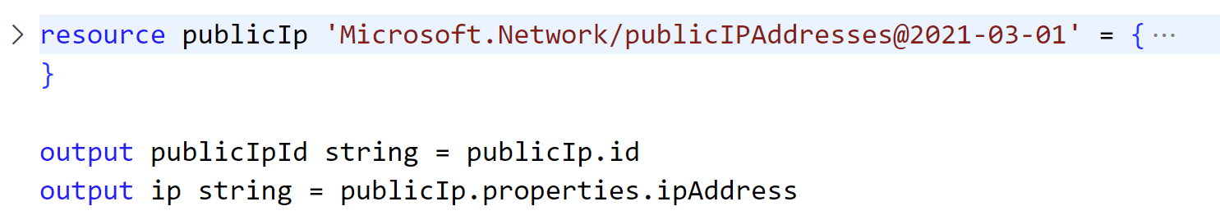
Outputs (output) – resource example

Slide 42
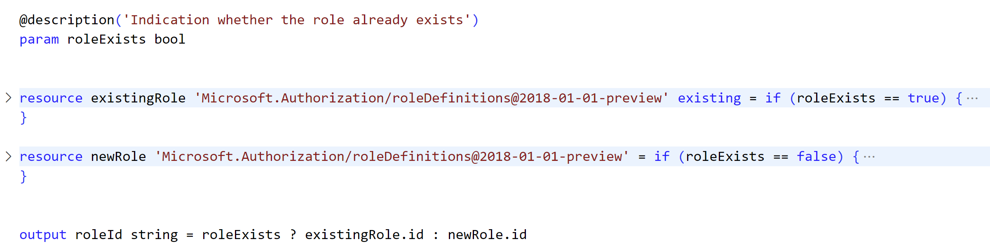
Outputs (output) – conditional output example

Slide 43
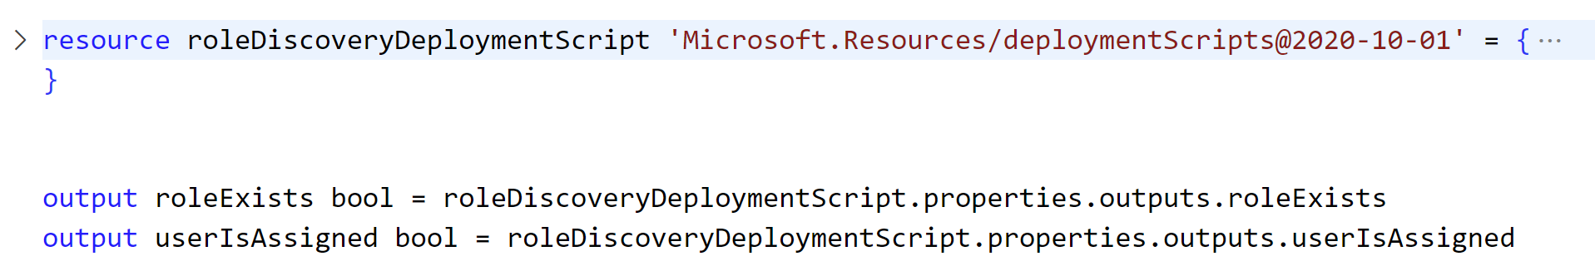
Outputs (output) – deployment script example

Slide 44
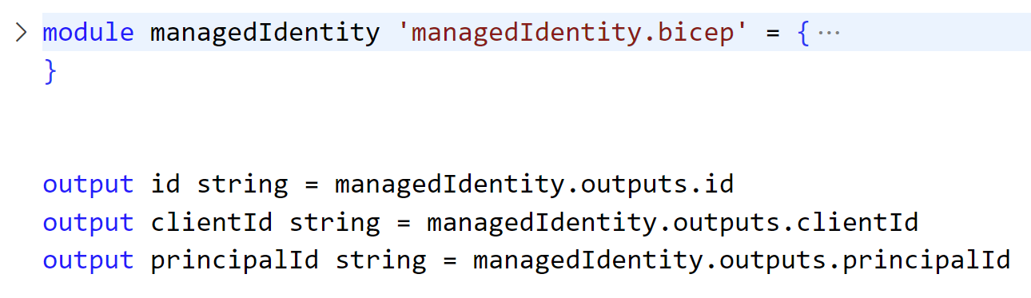
Outputs (output) – module example

Slide 45
Azure IaC with Bicep
an ode by a developer
https://www.linkedin.com/in/KatrienDHoker

